Slide 1
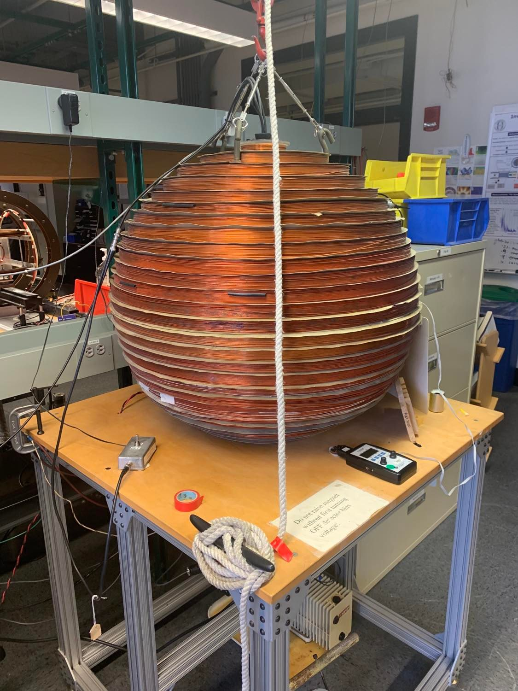
Finding the Electron Rest Mass and Validating Relativistic Kinematics
Octavio Vega
8.13 Junior Physics Lab
November 4, 2021

Slide 2
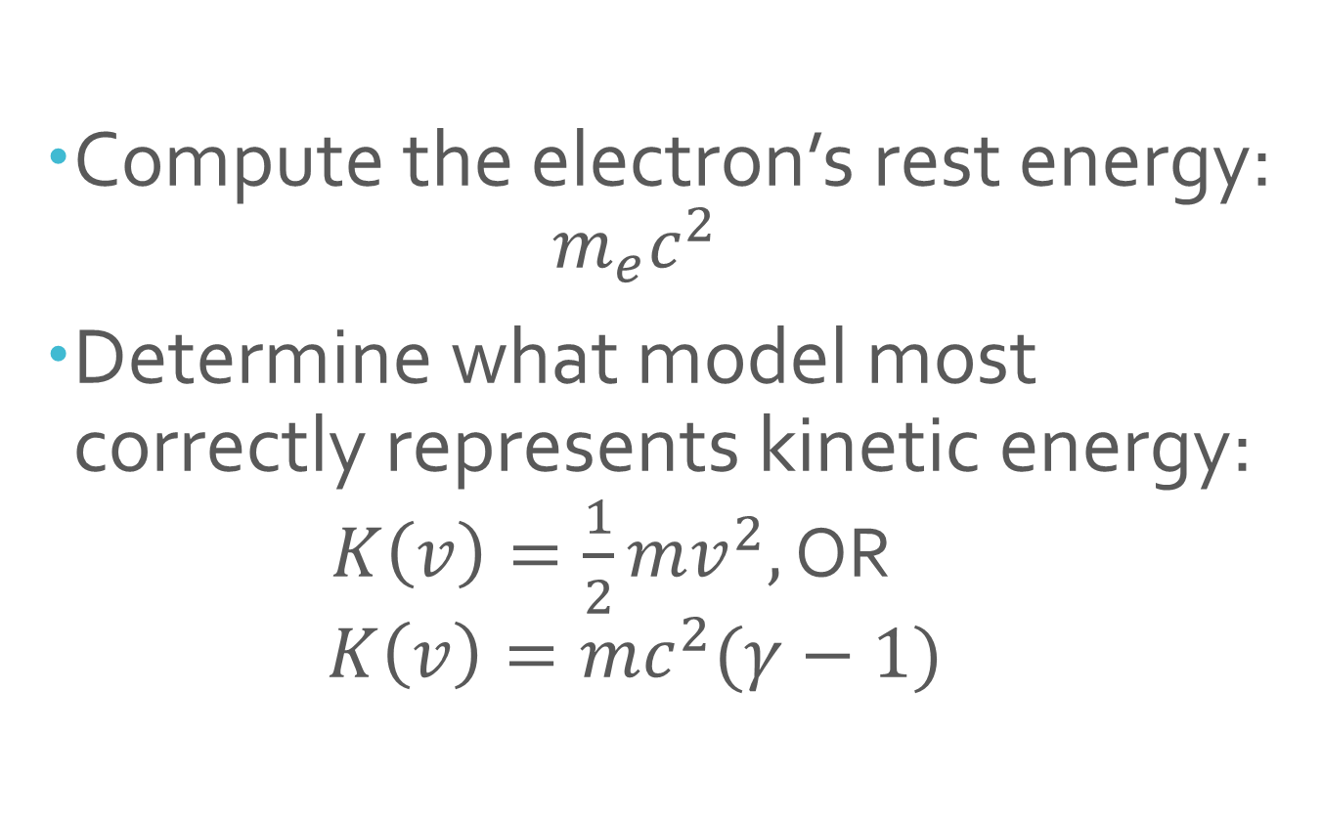
Experimental Goals
Compute the electron’s rest energy:
$$m_{e}c^{2}$$
Determine what model most correctly represents kinetic energy:
$K\left(v\right)=\frac{1}{2}mv^{2},$ OR
$$K\left(v\right)=mc^{2}(γ−1)$$

Slide 3
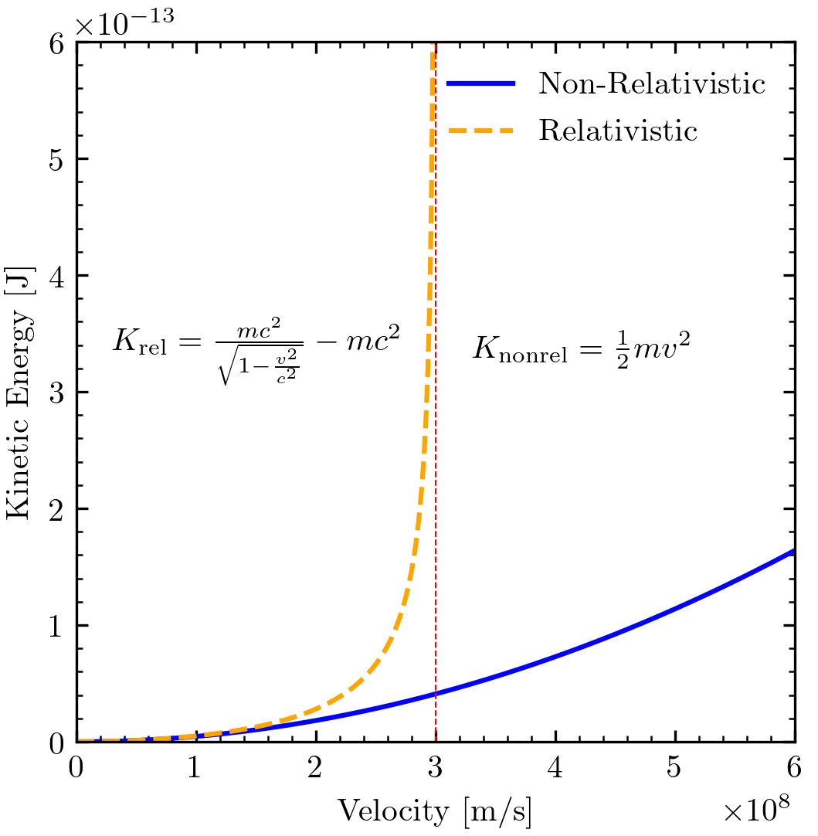
Theoretical Models of Kinetic Energy vs Velocity

Slide 4
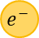
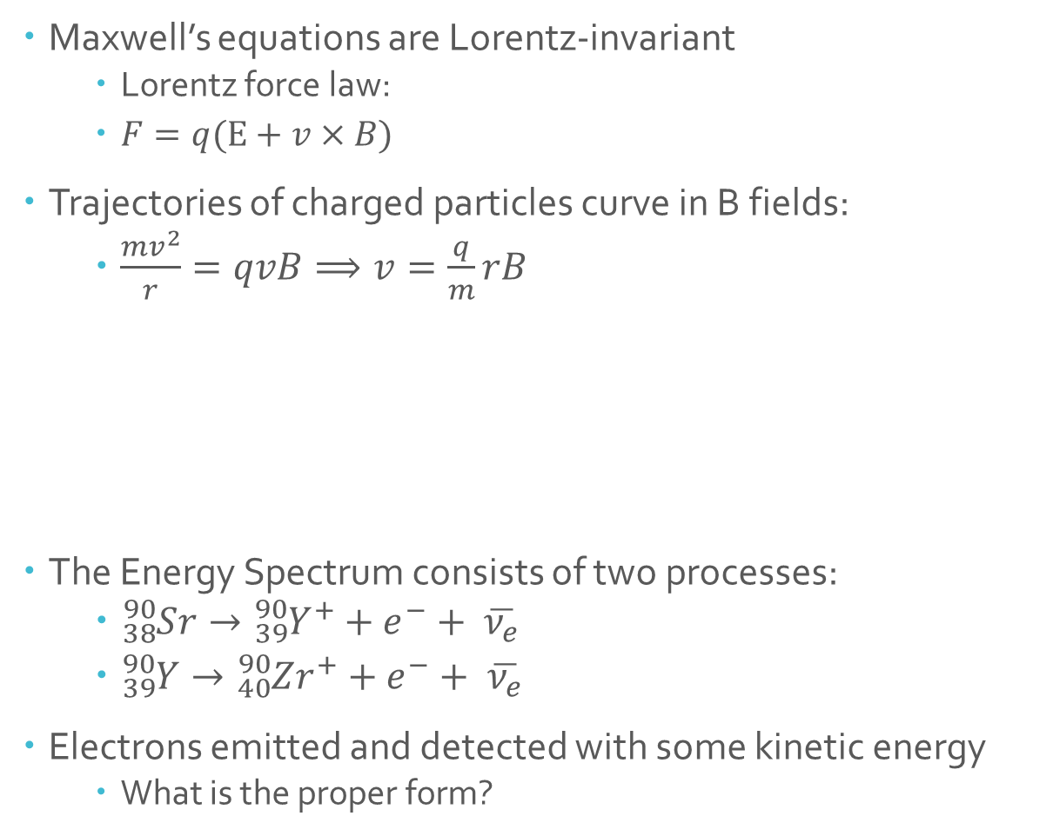
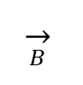
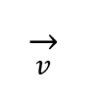
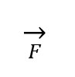
Background Theory of Charged Particles and Beta Decay
Maxwell’s equations are Lorentz-invariant
Lorentz force law:
$F=q(E+v×B)$
Trajectories of charged particles curve in B fields:
$\frac{mv^{2}}{r}=qvB⟹v=\frac{q}{m}rB$
The Energy Spectrum consists of two processes:
${}_{38}^{90}Sr→{{}_{39}^{90}Y}^{+}+e^{−}+ \overline{ν_{e}}$
${}_{39}^{90}Y→{}_{40}^{90}Zr^{+}+e^{−}+ \overline{ν_{e}}$
Electrons emitted and detected with some kinetic energy
What is the proper form?
$$\overset{→}{B}$$
$$\overset{→}{F}$$
$$\overset{→}{v}$$
$$e^{−}$$

Slide 5
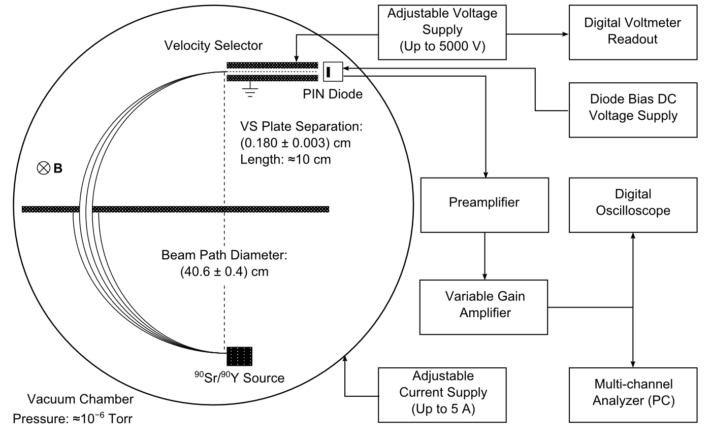
Apparatus Signal Chain
Figure 1: Schematic from MITx Page

Slide 6
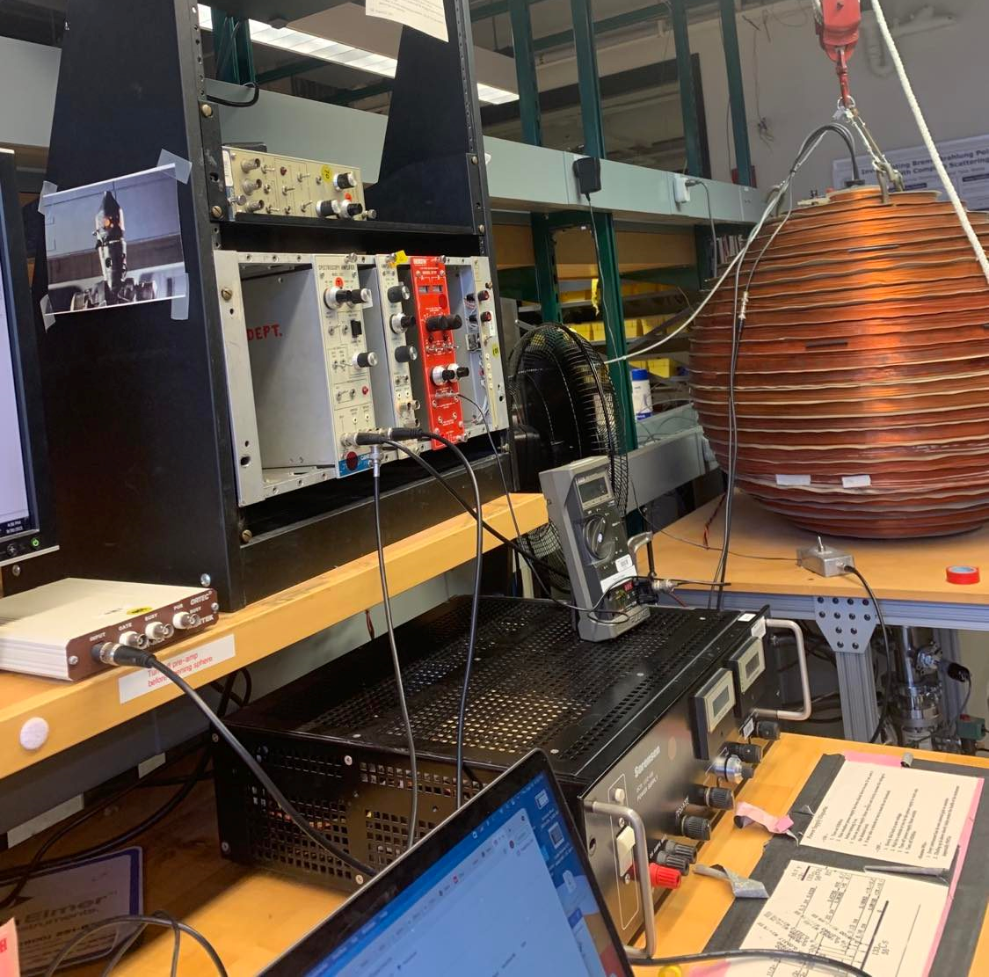
Laboratory Setup
voltage supply
amplifier
vacuum chamber
voltmeter
multi-channel analyzer
current supply

Slide 7
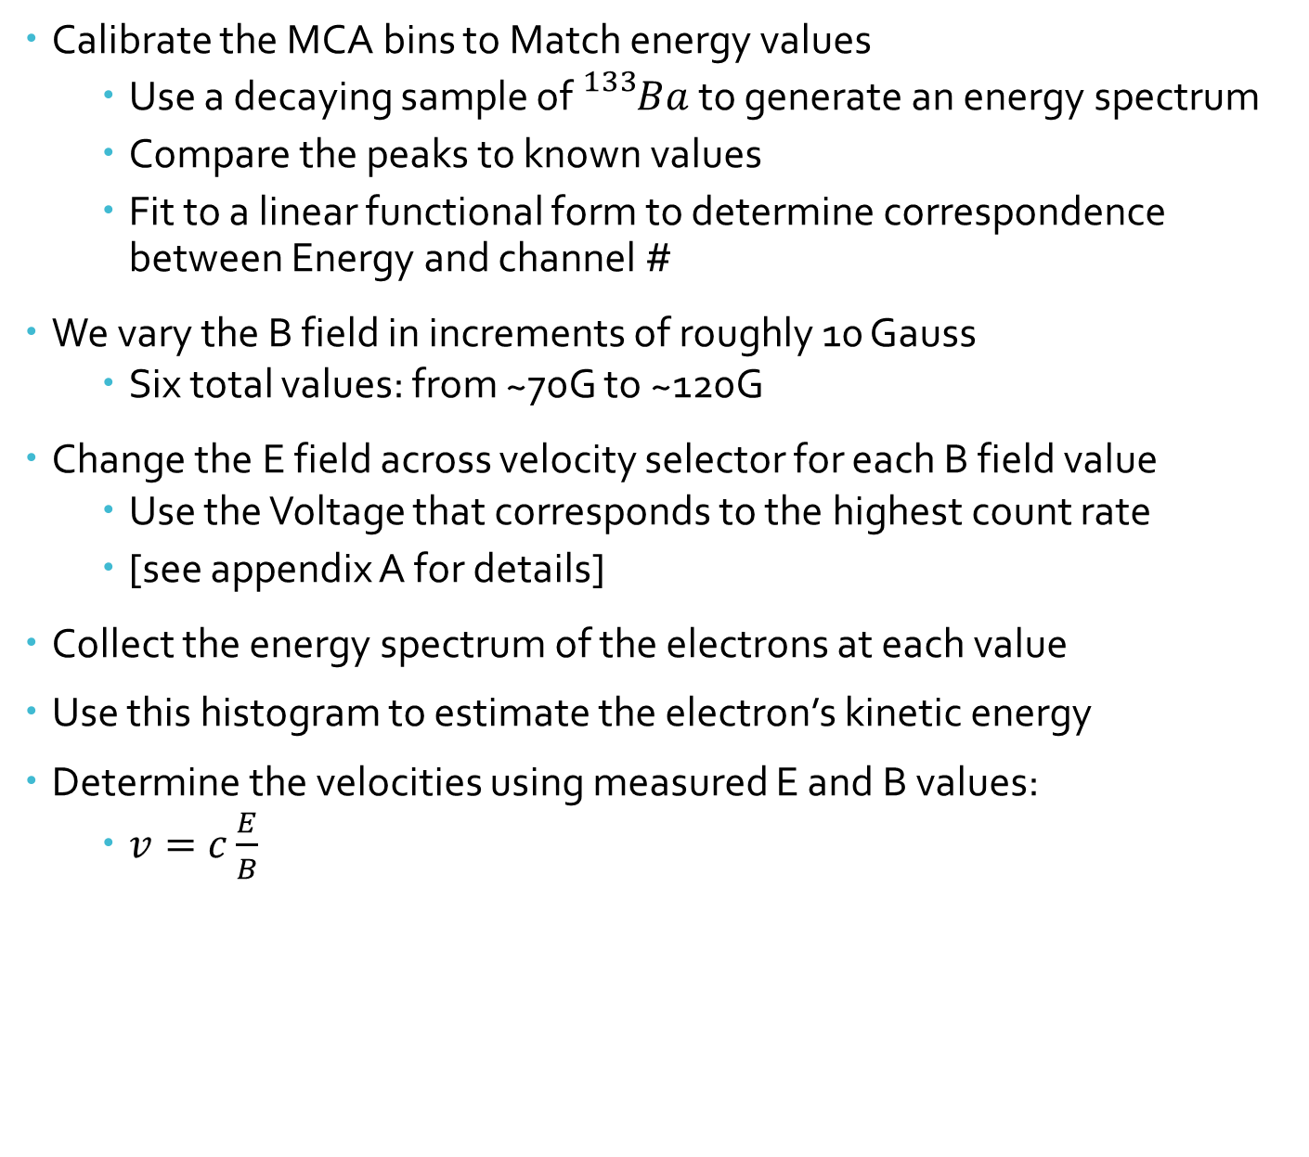
Data Collecting Scheme
Calibrate the MCA bins to Match energy values
Use a decaying sample of ${}_{}^{133}Ba$ to generate an energy spectrum
Compare the peaks to known values
Fit to a linear functional form to determine correspondence between Energy and channel #
We vary the B field in increments of roughly 10 Gauss
Six total values: from ~70G to ~120G
Change the E field across velocity selector for each B field value
Use the Voltage that corresponds to the highest count rate
[see appendix A for details]
Collect the energy spectrum of the electrons at each value
Use this histogram to estimate the electron’s kinetic energy
Determine the velocities using measured E and B values:
$v=c\frac{E}{B}$

Slide 8
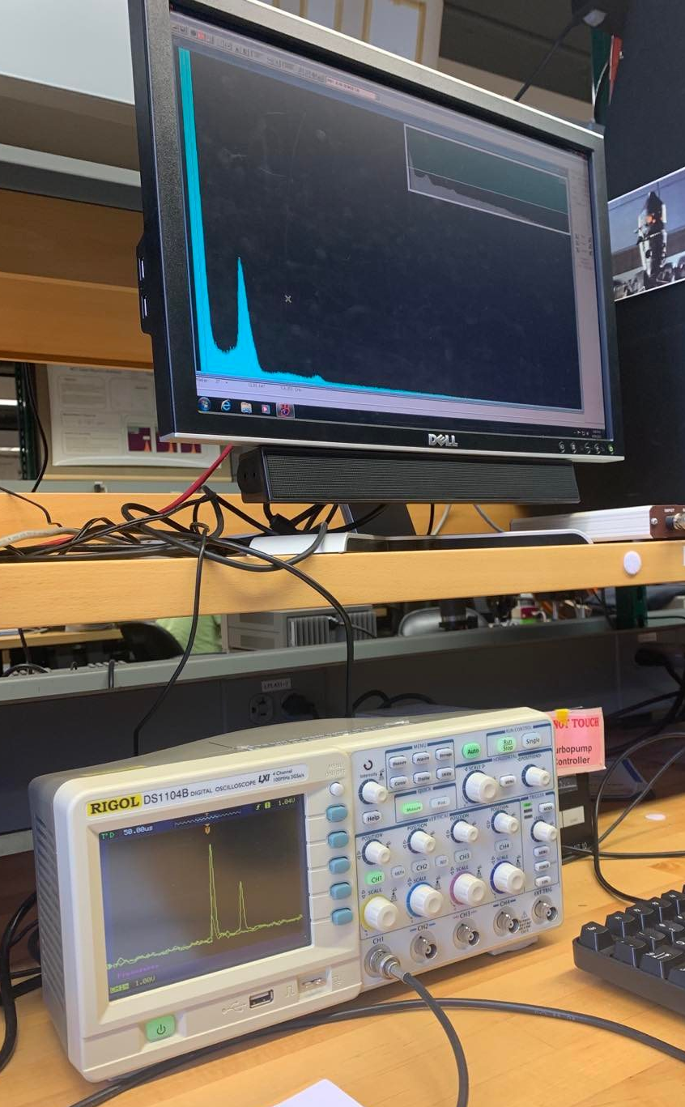
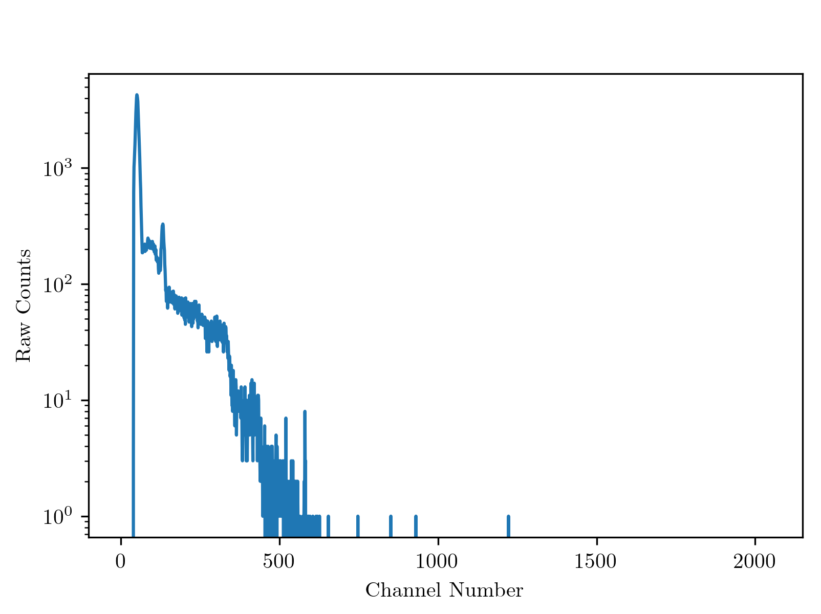
Calibrating the MCA

Slide 9
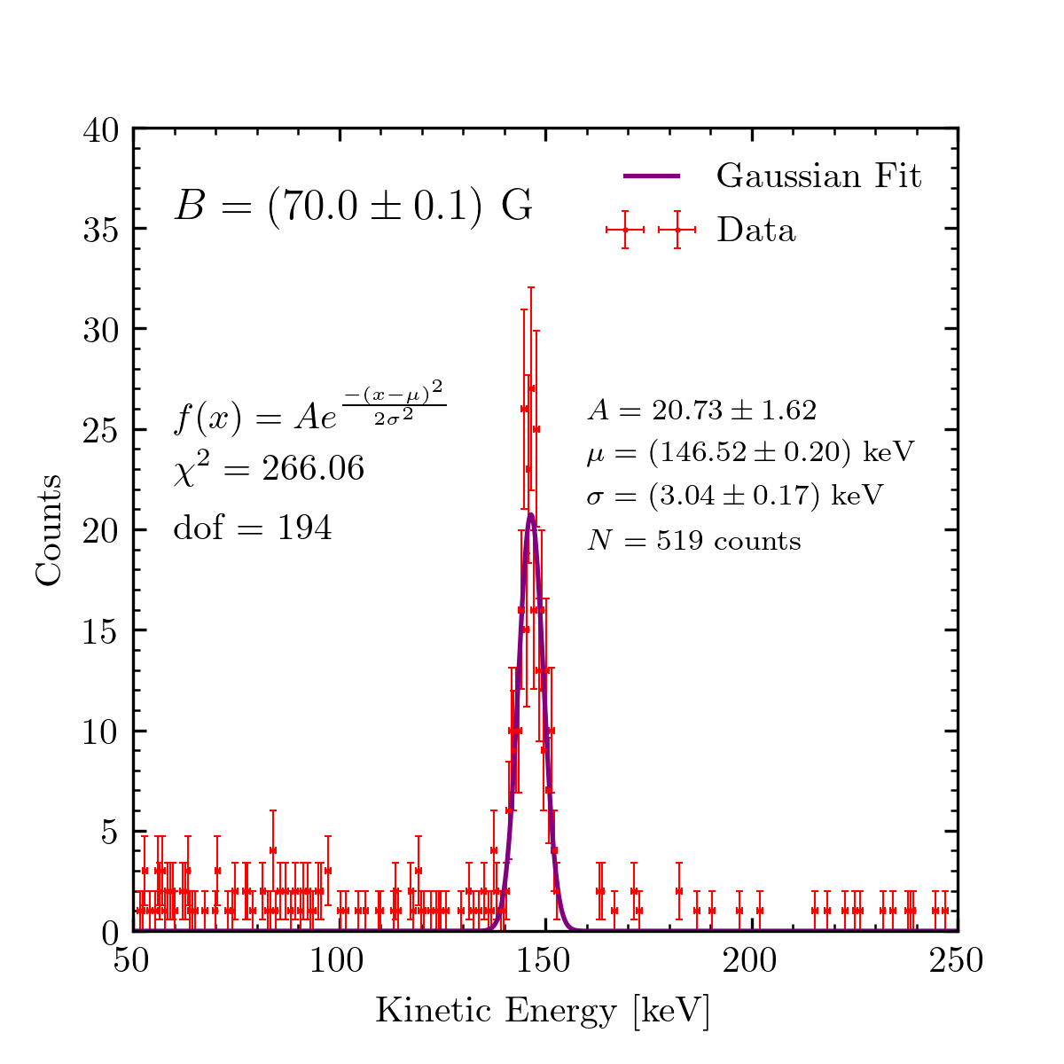
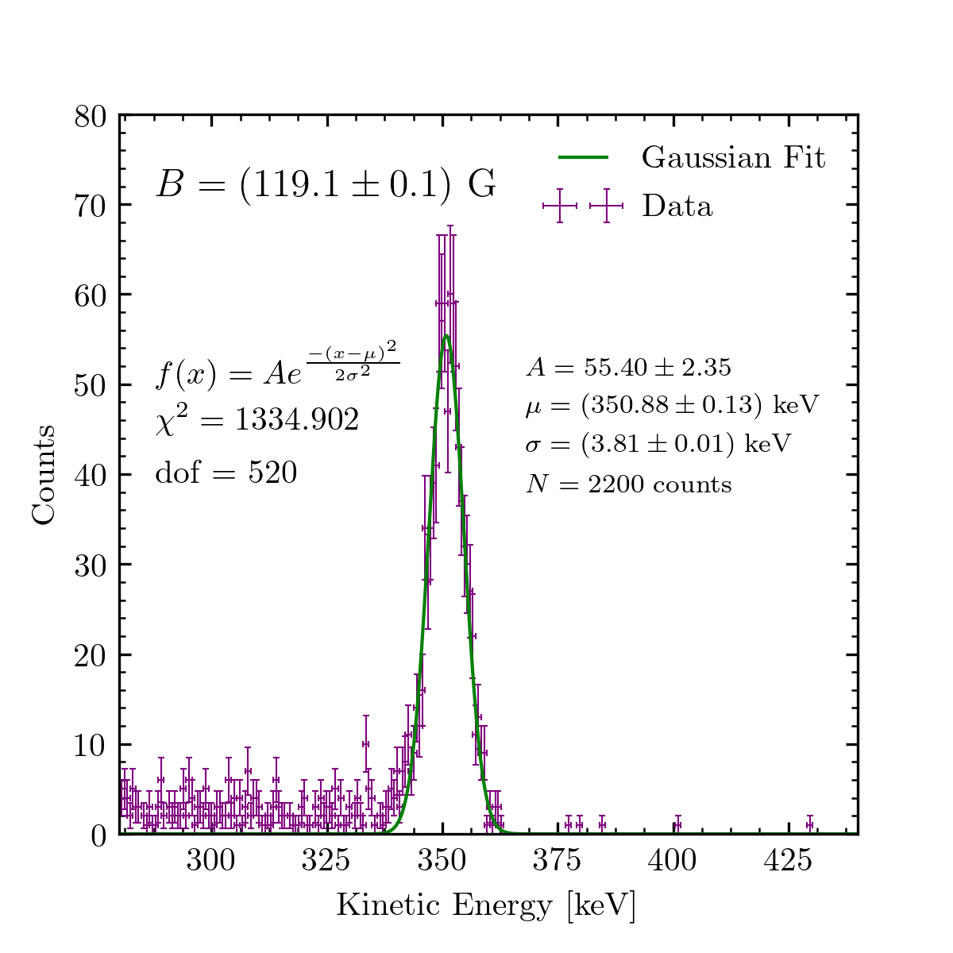
Raw Energy Spectra with Gaussian Fits

Slide 10
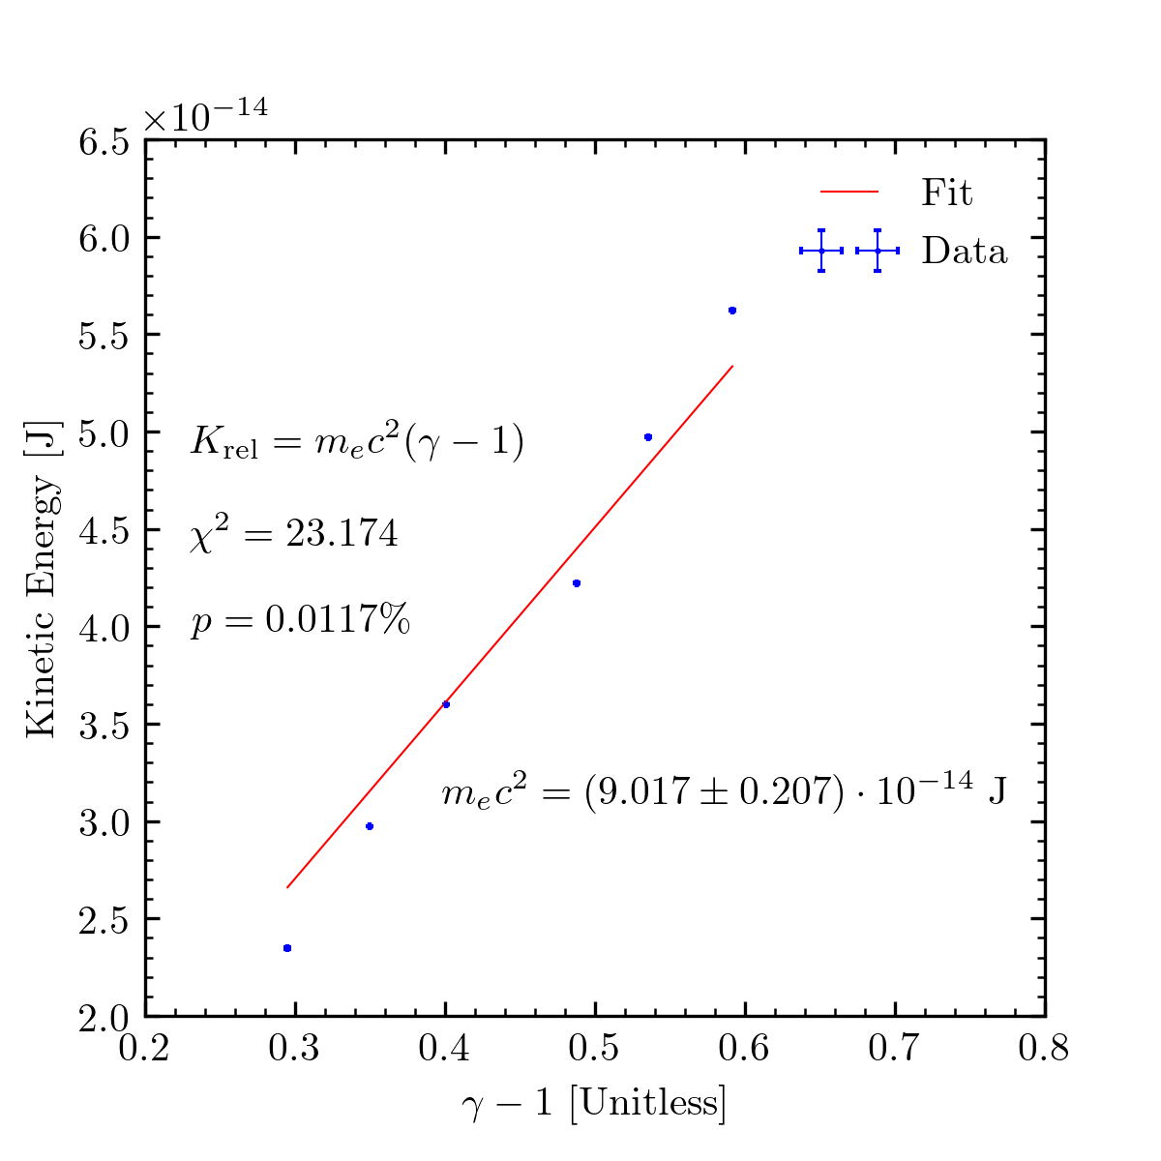
Fitting to the Rest Energy

Slide 11
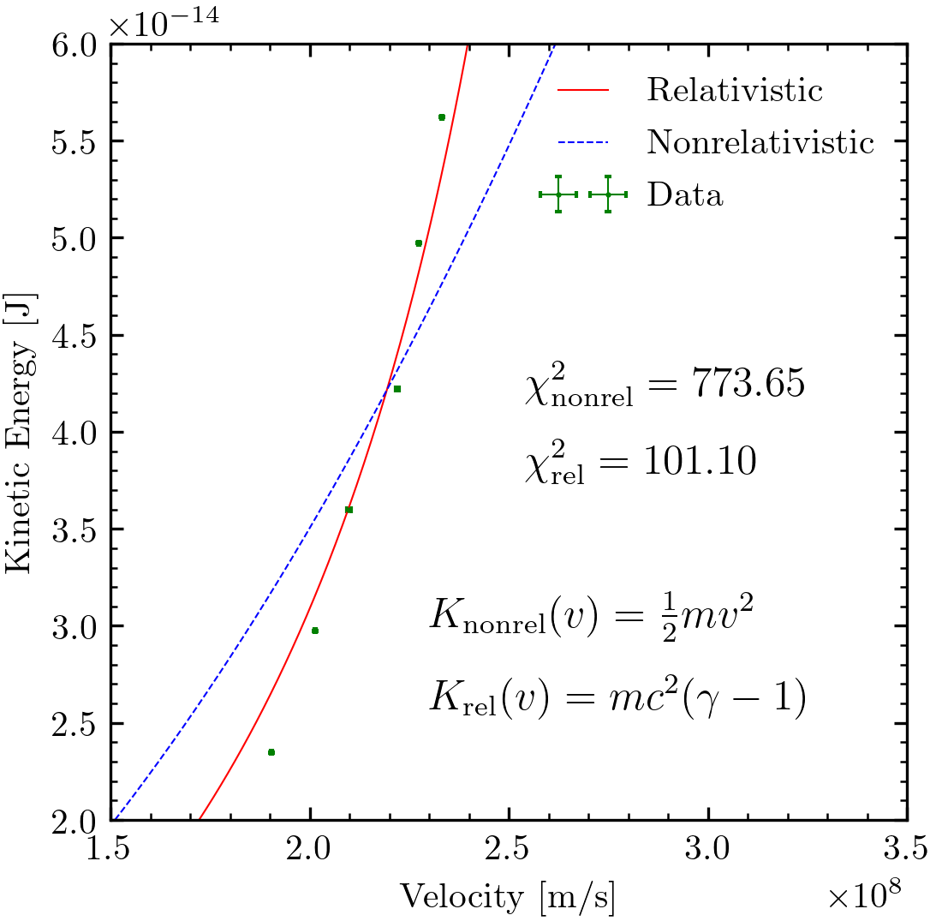
Comparison of Fit Models to Real Data

Slide 12
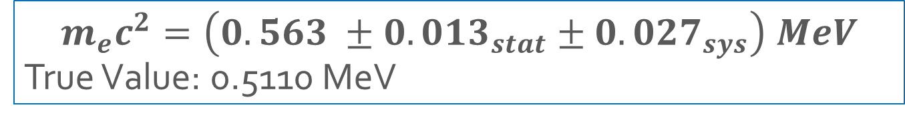
Results and Discussion of Errors
$$m_{e}c^{2}=\left(0.563 ±{0.013}_{stat}±{0.027}_{sys}\right) MeV$$
True Value: 0.5110 MeV
Statistical
Systematic
Incorrect fit function for energy spectra; account for background or additional signal?
Amplifier settings not consistent
Shielding of electrons in decay causes spread of radii
Emitted with other charged particles
Fewer trials than desired

Slide 13
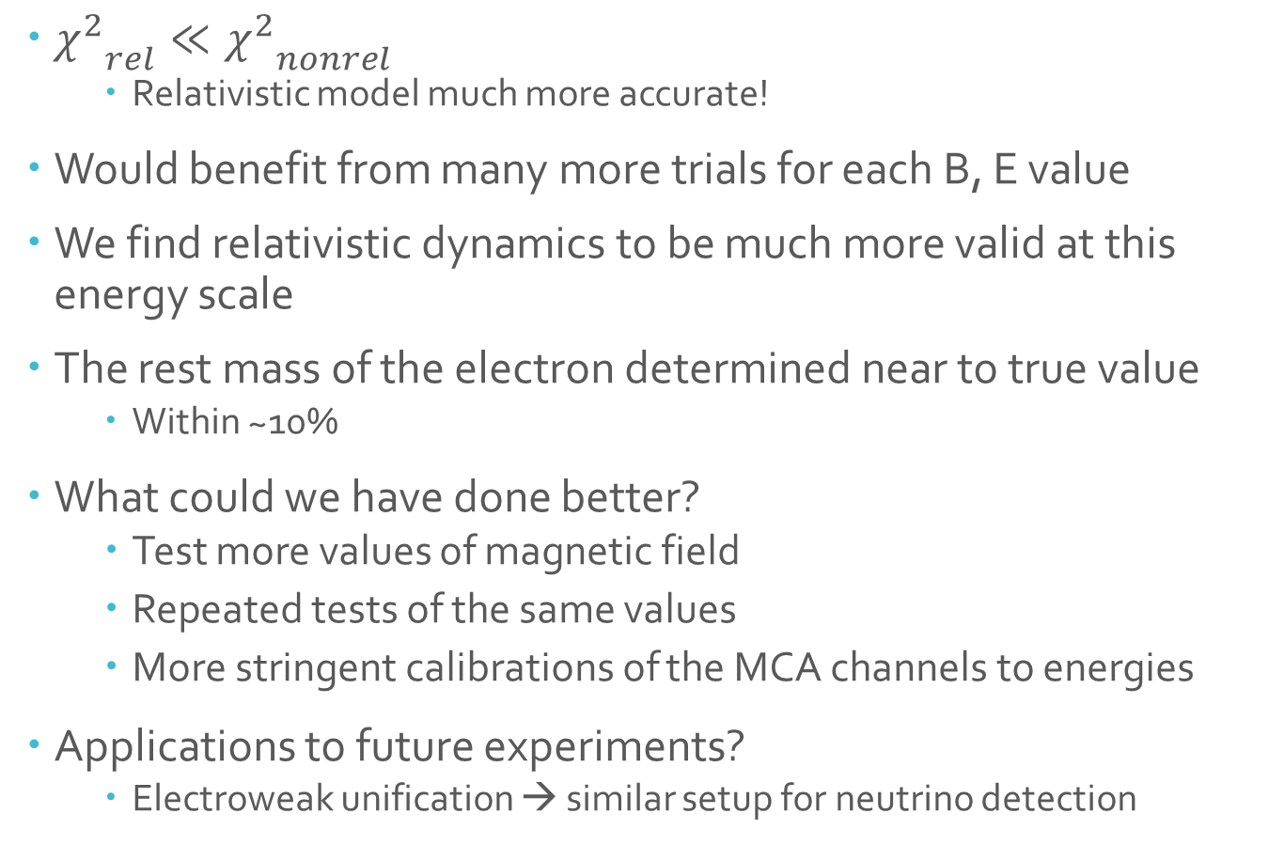
Summary and Conclusions
${χ^{2}}_{rel}≪{χ^{2}}_{nonrel}$
Relativistic model much more accurate!
Would benefit from many more trials for each B, E value
We find relativistic dynamics to be much more valid at this energy scale
The rest mass of the electron determined near to true value
Within ~10%
What could we have done better?
Test more values of magnetic field
Repeated tests of the same values
More stringent calibrations of the MCA channels to energies
Applications to future experiments?
Electroweak unification → similar setup for neutrino detection

Slide 14
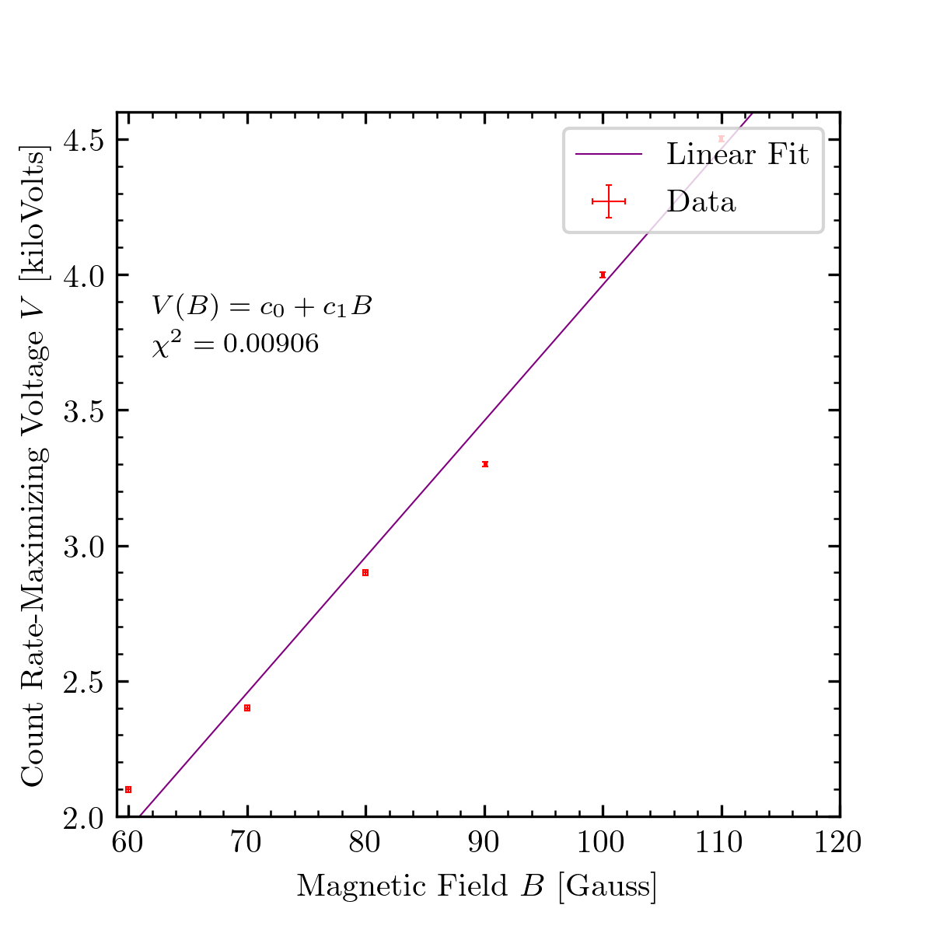
Appendix A: Count-Rate Maximizing Voltages

Slide 15
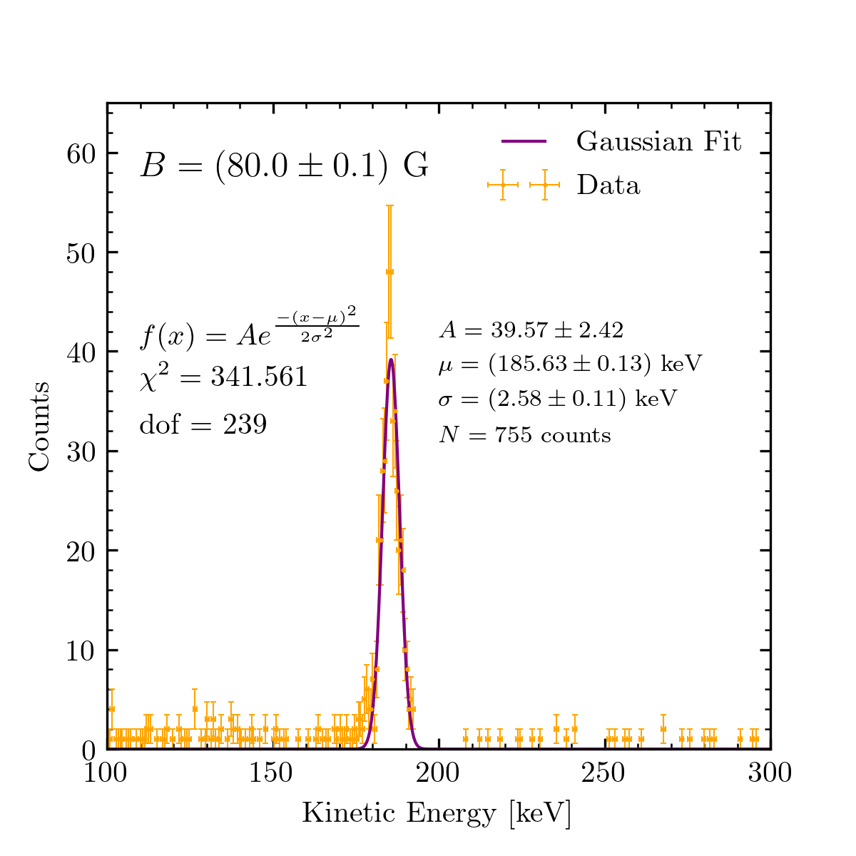
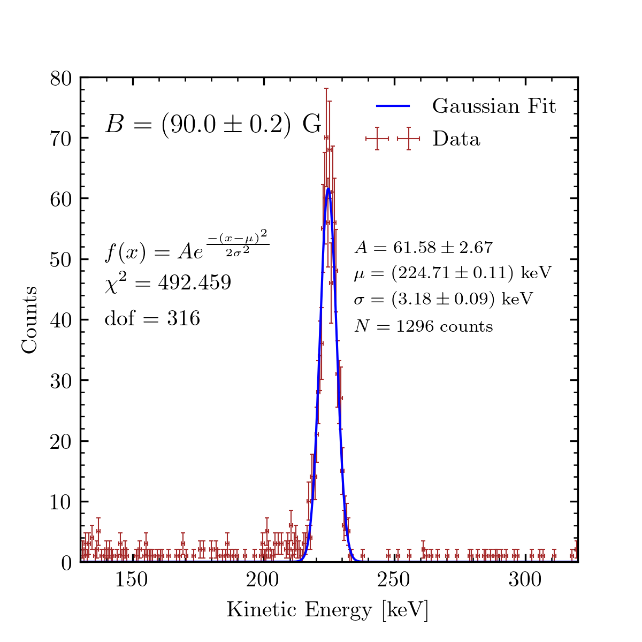
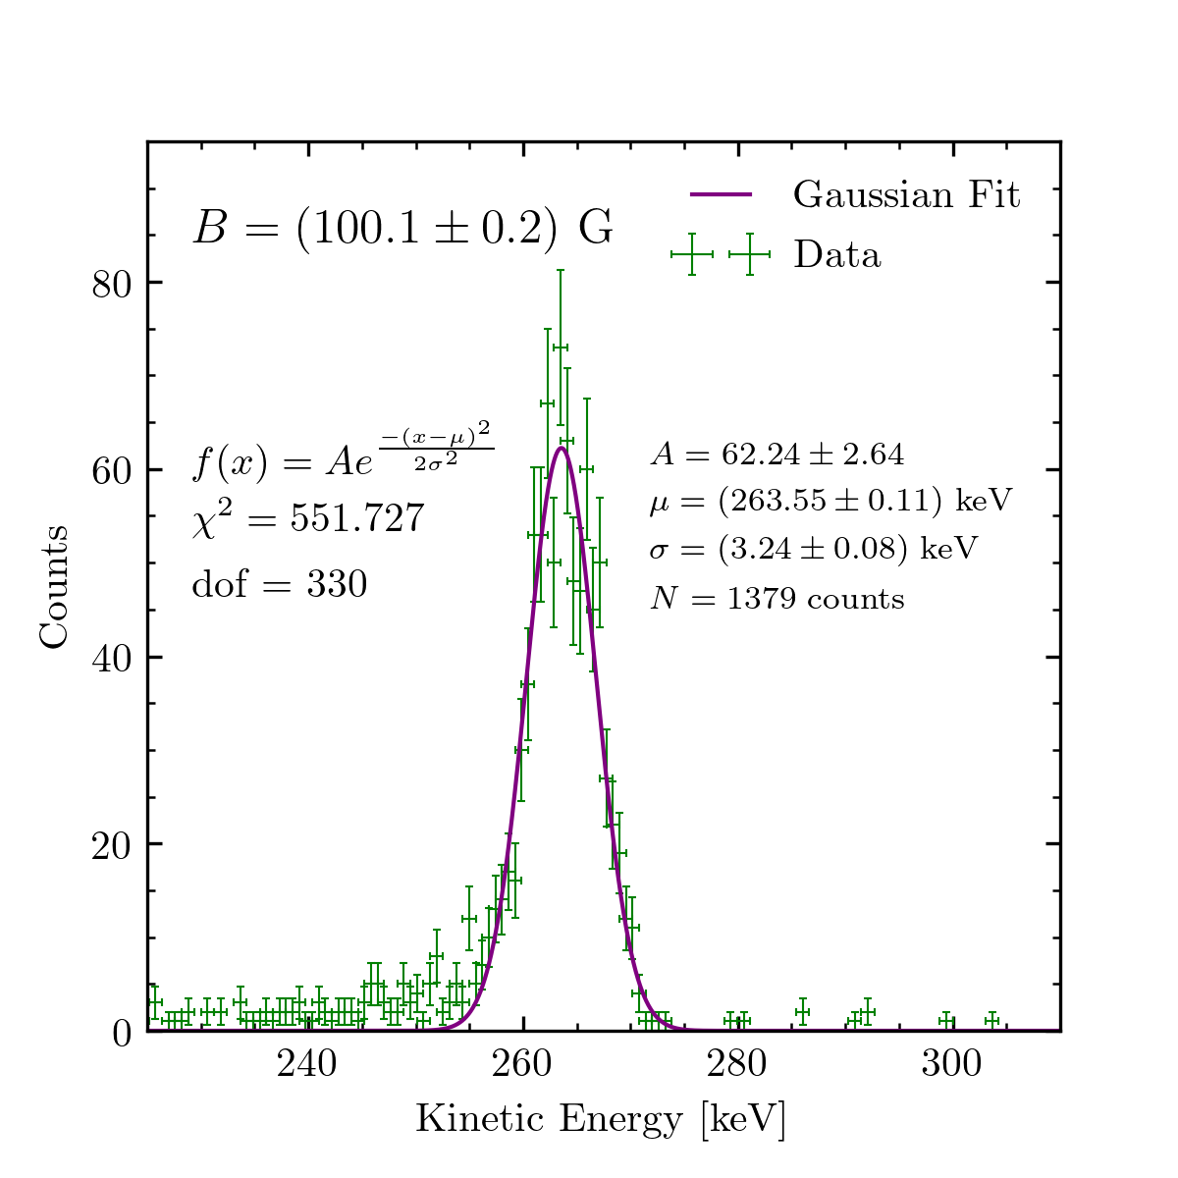
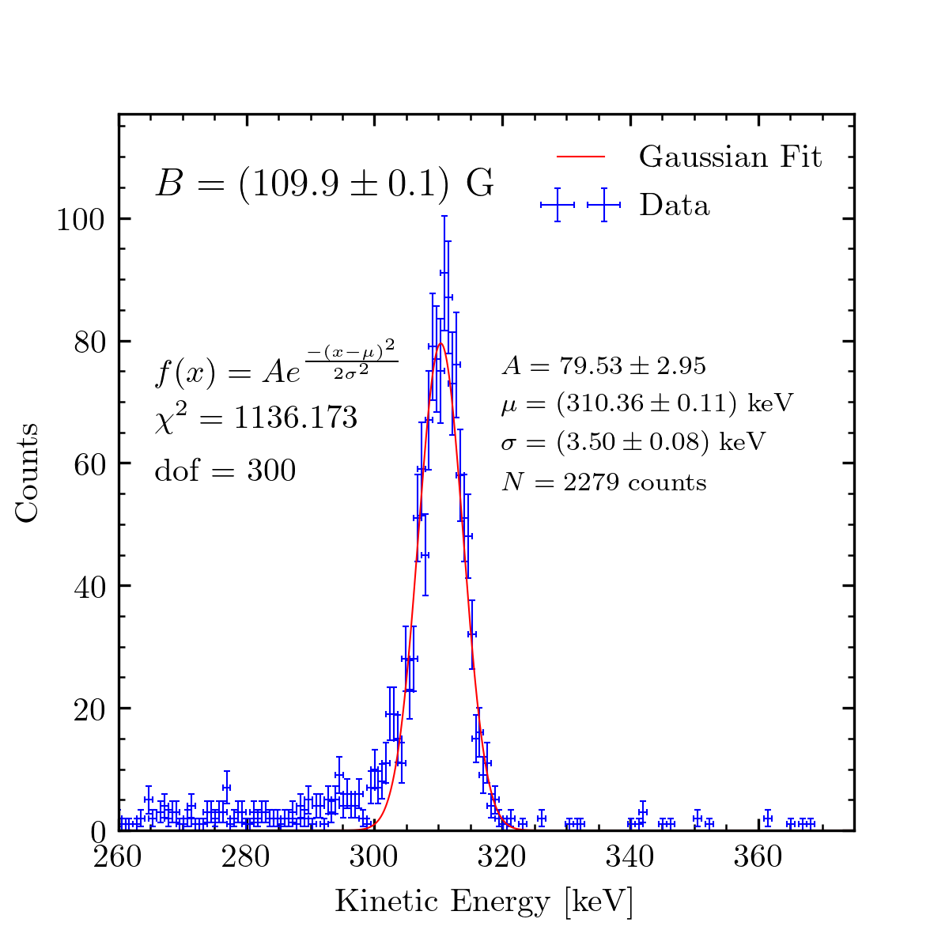
Appendix B: All Electron Energy Spectra

Slide 16
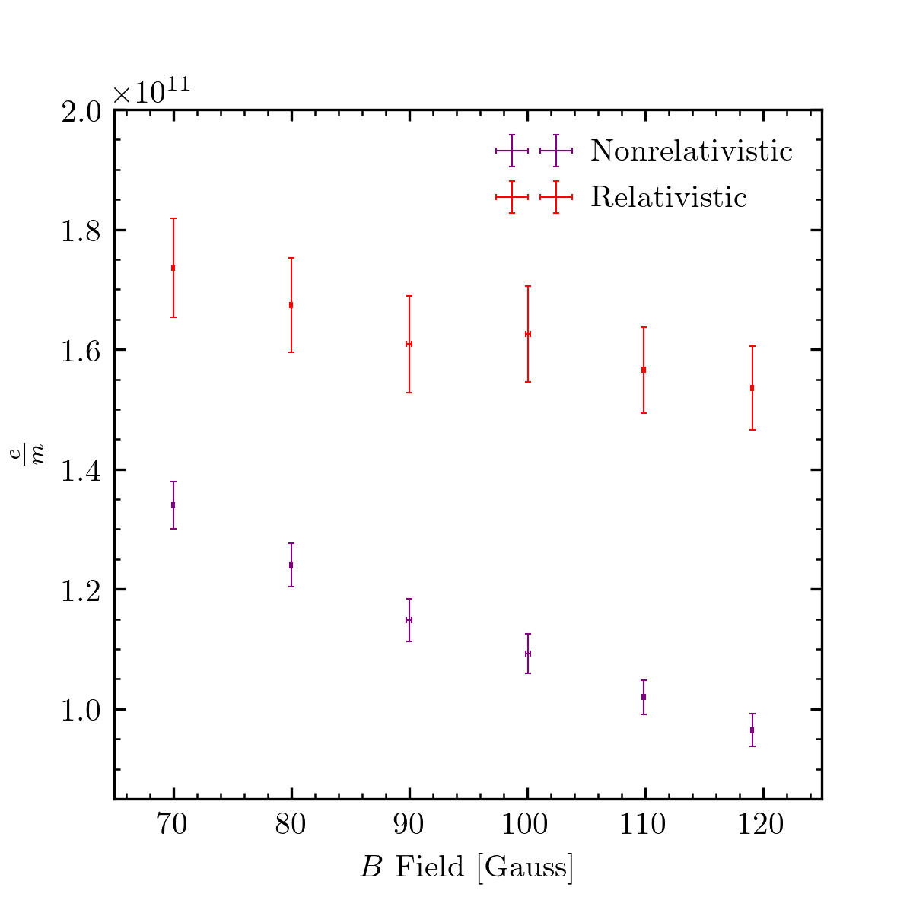
Appendix C: Ratio of e/m

